Slide 1
Chapter 10 Exception Handling

Slide 2
Motivations
An exception is an object that represents an error or a condition that prevents execution from proceeding normally. If the exception is not handled, the program terminates abnormally. How can you handle the runtime error so that the program can continue to run or terminate gracefully?

Slide 3
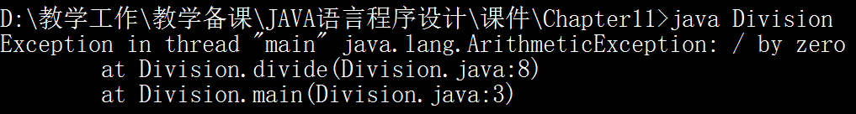
Case: Division
public static void main(String[] args){
divide(1, 0);
}
public static void divide(int a, int b){
System.out.println(a / b);
}

Slide 4
Case: Division with If
public static void divide(int a, int b){
if(b != 0)
System.out.println(a / b);
else
System.out.println("Divisor cannot be zero!");
}

Slide 5
Case: Division with Exception
public static void divide(int a, int b){
try{
System.out.println(a / b);
}catch(ArithmeticException ae){
System.out.println(ae.toString());
}
}

Slide 6
Case: Division with Exception
public static void divide(int a, int b){
try{
    if(b == 0)
      throw new ArithmeticException("Divisor cannot be zero!");
System.out.println(a / b);
}catch(ArithmeticException ae){
System.out.println(ae.toString());
}
}

Slide 7

System Errors
System errors are thrown by JVM and represented in the Error class. The Error class describes internal system errors. Such errors rarely occur. If one does, there is little you can do beyond notifying the user and trying to terminate the program gracefully.

Slide 8
Exceptions
Exception describes errors caused by your program and external circumstances. These errors can be caught and handled by your program.

Slide 9
Exceptions
RuntimeException is caused by programming errors, such as bad casting, accessing an out-of-bounds array, and numeric errors.

Slide 10
Checked Exceptions vs. Unchecked Exceptions
RuntimeException, Error and their subclasses are known as unchecked exceptions. All other exceptions are known as checked exceptions, meaning that the compiler forces the programmer to check and deal with the exceptions.

Slide 11
Unchecked Exceptions

Slide 12
Unchecked Exceptions
public static void main(String[] args){
throw new RuntimeException("A RuntimeException!");
}
public static void main(String[] args){
throw new Error("A Error!");
}

Slide 13
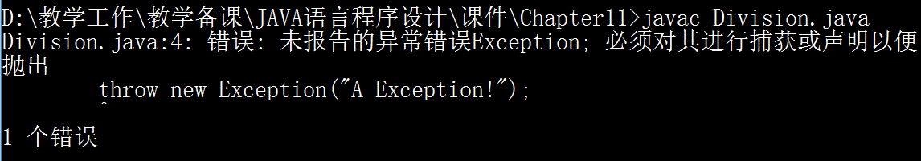
Checked Exceptions without catching
public static void main(String[] args){
//divide(1, 3);
throw new Exception("A Exception!");
}

Slide 14
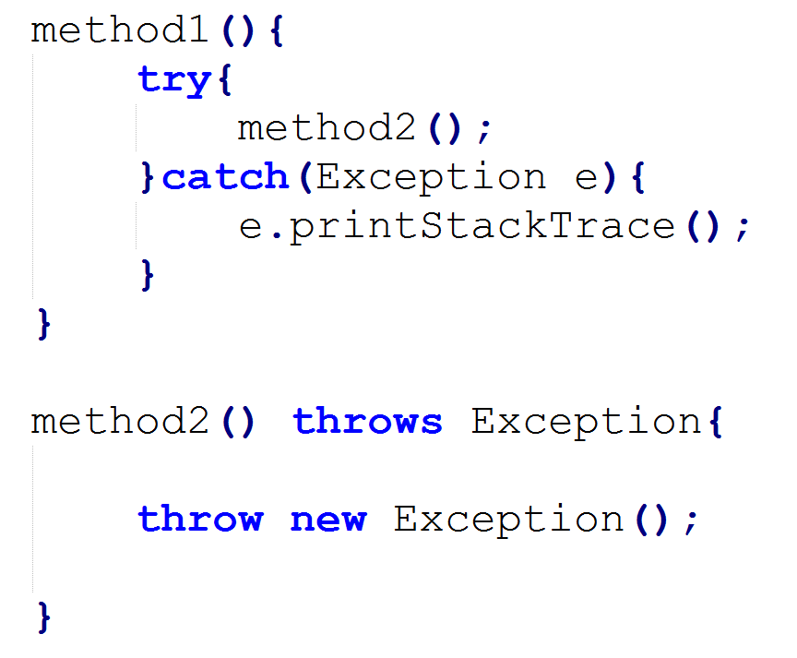
Declaring, Throwing, and Catching Exceptions
Catching Exceptions
Declaring Exceptions
Throwing Exceptions

Slide 15
Declaring Exceptions
Every method must state the types of checked exceptions it might throw. This is known as declaring exceptions.
public void myMethod() throws IOException
public void myMethod() throws IOException, OtherException

Slide 16
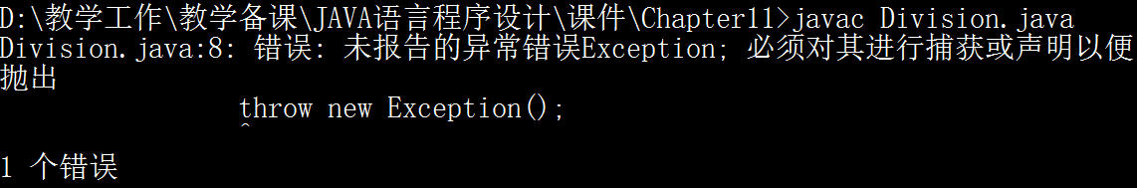
Checked Exception Without Declaring
public static void method(){
throw new Exception();
}
Correct the program:
public static void method() throws Exception{
throw new Exception();
}

Slide 17
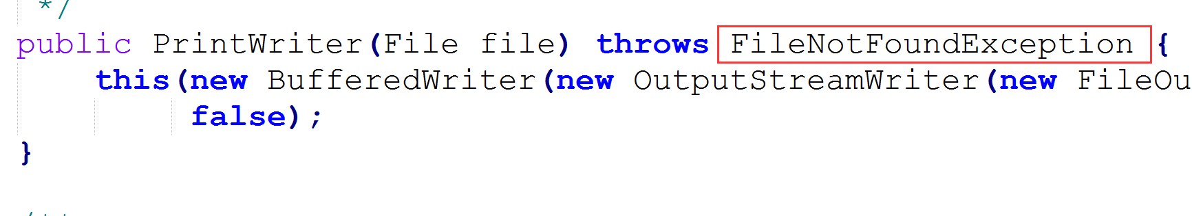
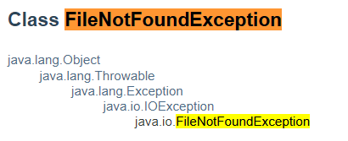
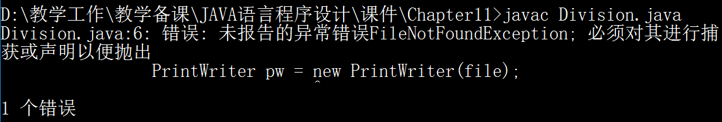
Using PrintWriter without catching or declaring
public static void main(String[] args){
File file = new File("t.txt");
PrintWriter pw = new PrintWriter(file);
}

Slide 18
Throwing Exceptions
When the program detects an error, the program can create an instance of an appropriate exception type and throw it. This is known as throwing an exception. Here is an example,
throw new TheException();
TheException ex = new TheException();
throw ex;

Slide 19
Throwing Exceptions
public static void main(String[] args){
try{
throw new Exception();
System.out.println("Do something after throwing!");
}catch(Exception e){
}
System.out.println("Do something after catching!");
}
Cannot run
Can run

Slide 20
Catching Exceptions
try {
statements; // Statements that may throw exceptions
}
catch (Exception1 exVar1) {
handler for exception1;
}
catch (Exception2 exVar2) {
handler for exception2;
}
...
catch (ExceptionN exVar3) {
handler for exceptionN;
}

Slide 21
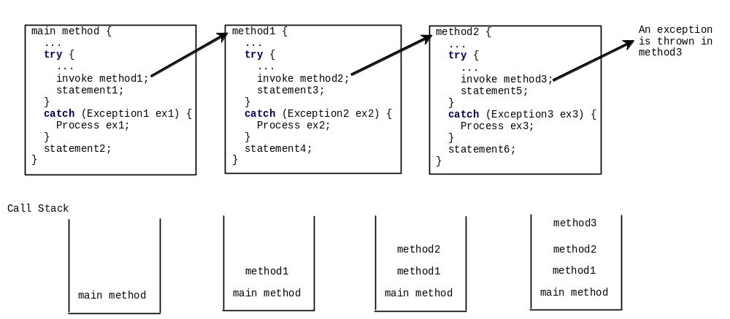
Catching exceptions thrown by called methods

Slide 22
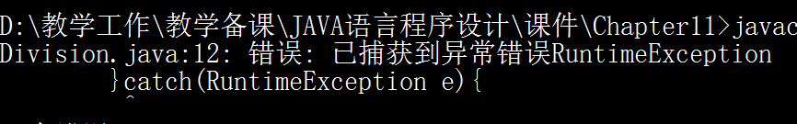
Super-Exception and Sub-Exception Catching
try{
throw new Exception();
}catch(RuntimeException re){
re.printStackTrace();
}catch(Exception e){
e.printStackTrace();
}
try{
throw new Exception();
}catch(Exception e){
e.printStackTrace();
}catch(RuntimeException re){
re.printStackTrace();
}

Slide 23
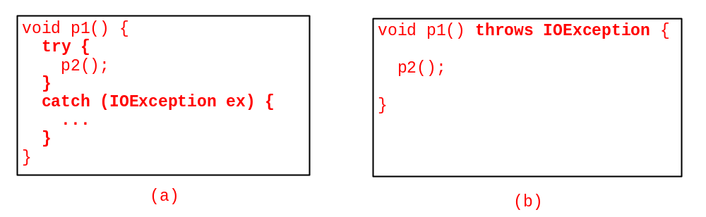
Catch or Declare Checked Exceptions
Java forces you to deal with checked exceptions. If a method declares a checked exception (i.e., an exception other than Error or RuntimeException), you must invoke it in a try-catch block or declare to throw the exception in the calling method. For example, suppose that method p1 invokes method p2 and p2 may throw a checked exception (e.g., IOException), you have to write the code as shown in (a) or (b).

Slide 24
Rethrowing Exceptions
try {
statements;
}
catch(TheException ex) {
perform operations before exits;
throw ex;
}

Slide 25
The finally Clause
try {
statements;
}
catch(TheException ex) {
handling ex;
}
finally {
finalStatements;
}

Slide 26
The finally Clause
Suppose no exceptions in the statements
try {
statements;
}
catch(TheException ex) {
handling ex;
}
finally {
finalStatements;
}
Next statement;
1
2
3

Slide 27
The finally Clause
Suppose an exception of type Exception1 is thrown in statement
try {
statements;
}
catch(Exception1 ex) {
handling ex;
}
finally {
finalStatements;
}
Next statement;
1
2
3
4

Slide 28
The finally Clause
try {
  statements;
}
catch(Exception1 ex) {
  handling ex;
  throw ex;
}
finally {
  finalStatements;
}
Next statement;
Rethrow the exception and control is transferred to the caller
1
2
4
3

